Slide 1
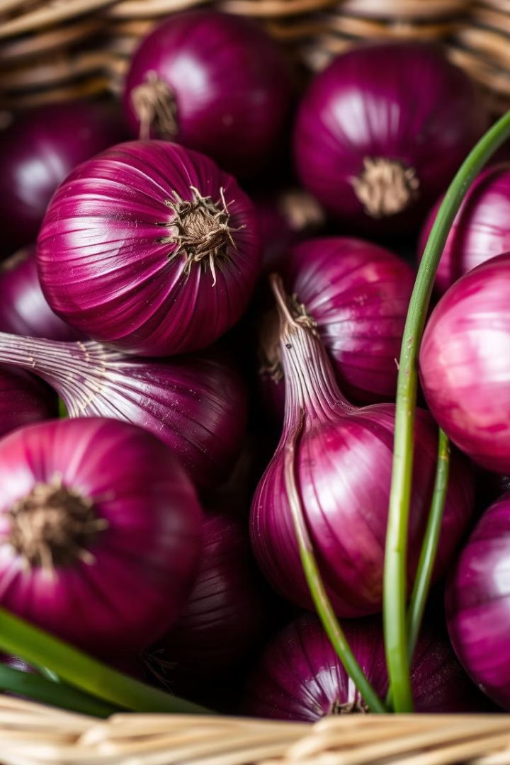
Optimizing Onion Storage for Maximum Yield
Maintaining optimal storage conditions for onions is crucial to minimize post-harvest losses and preserve the quality of the crop. This presentation outlines the key factors for creating a successful onion storage environment. Proper storage ensures longevity, preventing spoilage and ensuring maximum yield for farmers and consumers alike.

Slide 2
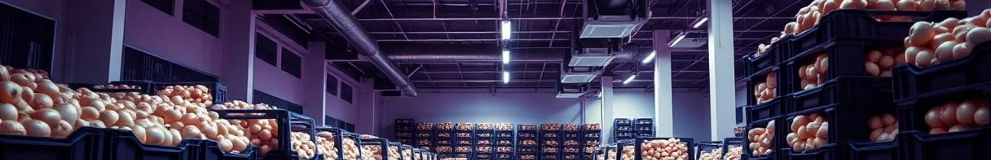
Dry Conditions
1
Moisture Control
2
Preventing Spoilage
Excess moisture can lead to fungal growth, spoilage, and decay. Maintaining a dry environment is essential to prevent these issues. This can be achieved through proper ventilation, air circulation, and moisture-absorbing materials.
Moisture encourages the growth of harmful microorganisms that can damage onions, causing them to soften, rot, and become unusable. By minimizing moisture, you protect your onion stock from premature deterioration.
3
Extending Shelf Life
4
Maintaining Quality
Dry conditions help maintain the firmness and texture of onions, extending their shelf life and preventing them from becoming soft or mushy. This ensures that onions remain fresh and flavorful for a longer period.
Proper moisture control allows onions to retain their visual appeal, preventing browning and discoloration. This ensures that onions maintain their quality and remain attractive for consumers.

Slide 3
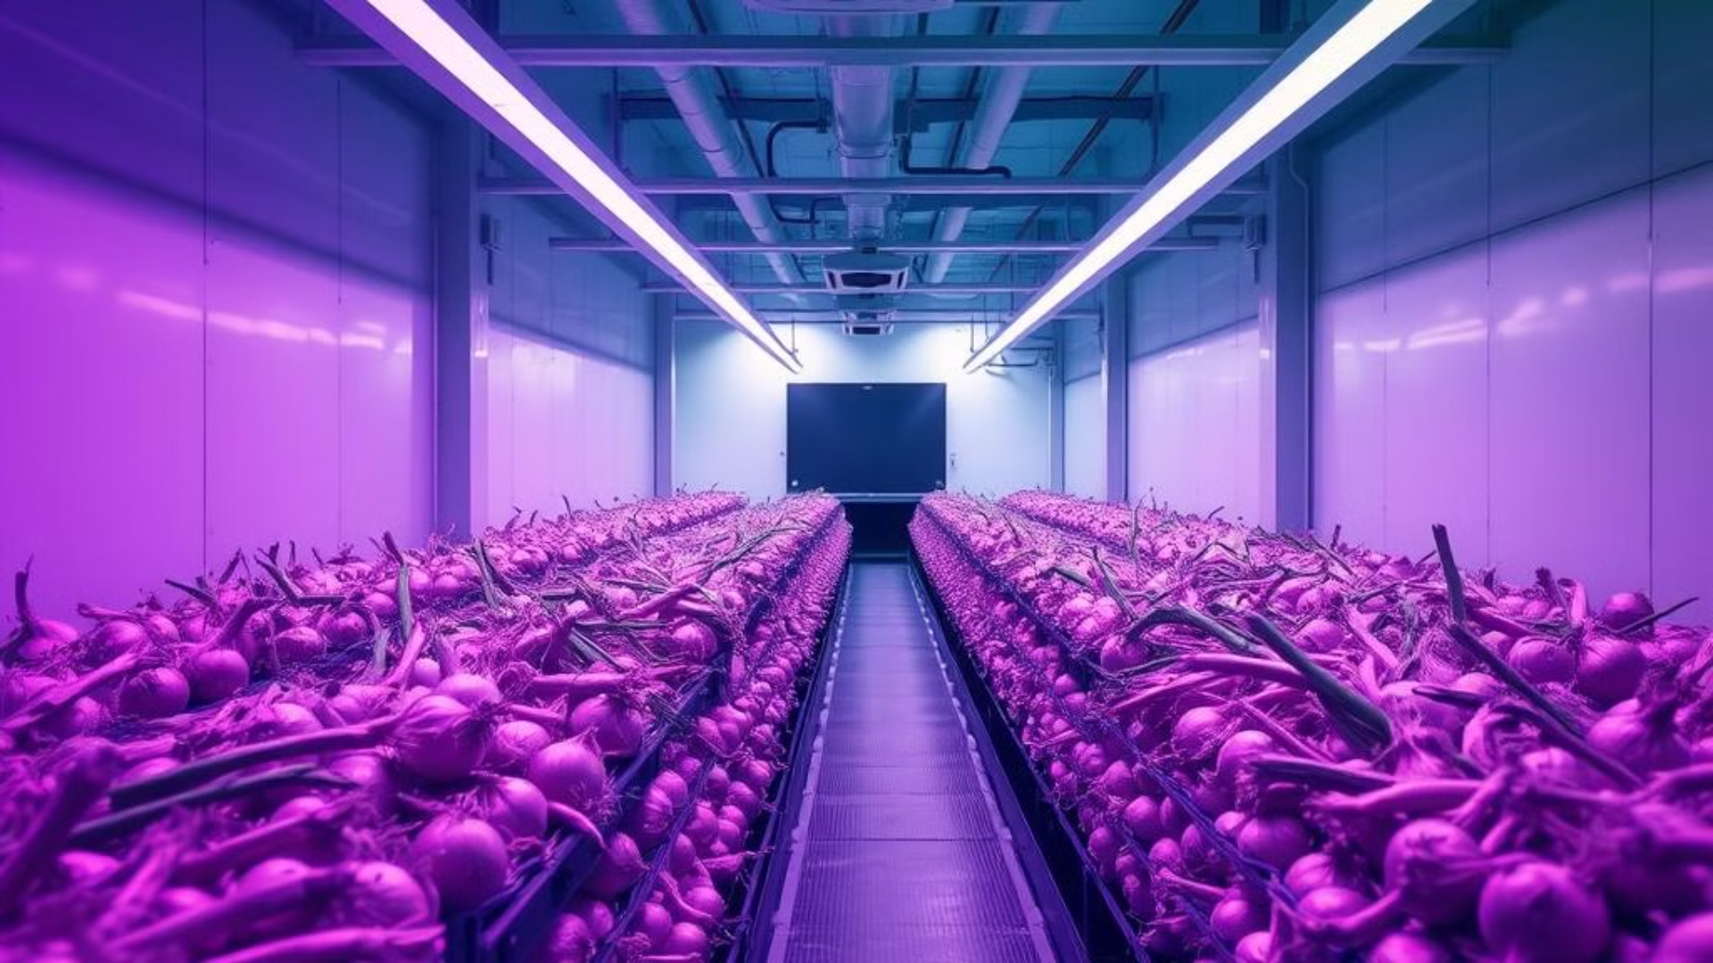
Well-Ventilated Space
Air Circulation
Temperature Regulation
Moisture Dispersion
Adequate ventilation ensures proper air circulation within the storage space. This helps prevent the buildup of moisture, gases, and odors that can negatively impact the quality of the onions.
Ventilation helps regulate the temperature within the storage space. Proper air circulation prevents heat buildup, which can lead to spoilage and premature aging of the onions.
Ventilation facilitates the dispersal of moisture from the onions and the surrounding environment. This keeps the storage area dry and inhibits the growth of fungi and bacteria that can damage the onions.

Slide 4

Dark Environment
Preventing Sprouting
Protecting Flavor
Light exposure can stimulate the germination process, causing onions to sprout. A dark environment inhibits sprouting, preserving the onions' quality and longevity.
Light can degrade the onion's natural pigments, affecting its flavor and aroma. Storing onions in a dark environment helps maintain their distinct flavor profiles.
Minimizing Browning
Preserving Nutritional Value
Exposure to light can cause onions to turn brown and discolored. Darkness prevents this, maintaining the onions' fresh appearance and marketability.
Light can degrade the vitamins and antioxidants present in onions. Dark storage preserves their nutritional value, ensuring that consumers benefit from their health-promoting properties.

Slide 5
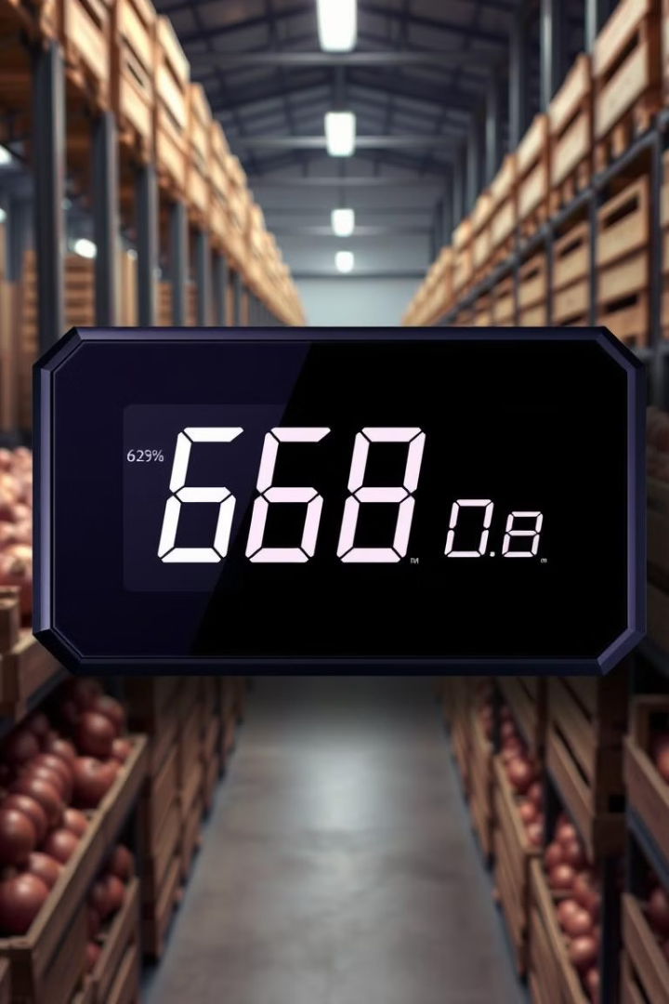
Humidity Range: 65-70%
Low Humidity
Can lead to dehydration, shriveling, and weight loss of onions.
High Humidity
Encourages fungal growth, spoilage, and decay of onions.
Ideal Humidity
Maintains moisture balance, preventing dehydration and encouraging longevity.

Slide 6
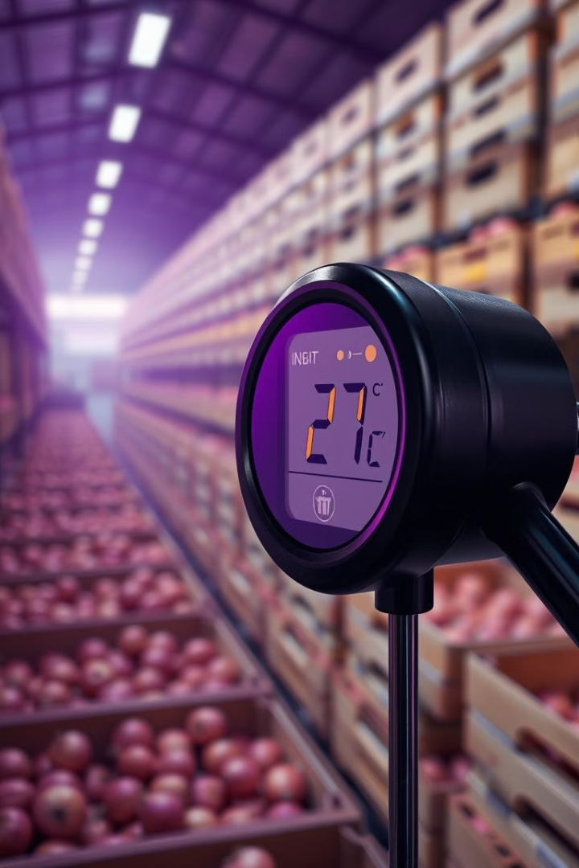
Temperature Range: 25-30°C
1
Low Temperatures
Can cause chilling injury, leading to discoloration, wilting, and reduced quality of onions.
2
High Temperatures
Can accelerate spoilage, causing onions to rot and become unusable.
3
Ideal Temperature
Maintains optimal conditions for onion storage, slowing down spoilage and preserving quality.

Slide 7





IoT Circuit Monitoring
Temperature Control
Humidity Control
IoT sensors provide constant monitoring of temperature levels, ensuring that the storage environment remains within the optimal range.
IoT sensors track humidity levels, alerting operators to any deviations from the ideal range, allowing for timely adjustments to maintain optimal conditions.
Real-time Alerts
Data Logging
The IoT system triggers alerts if temperature or humidity levels exceed pre-set thresholds, enabling prompt intervention to prevent spoilage and maintain quality.
IoT sensors record data over time, providing valuable insights into storage conditions and facilitating analysis for optimizing future storage strategies.

Slide 8

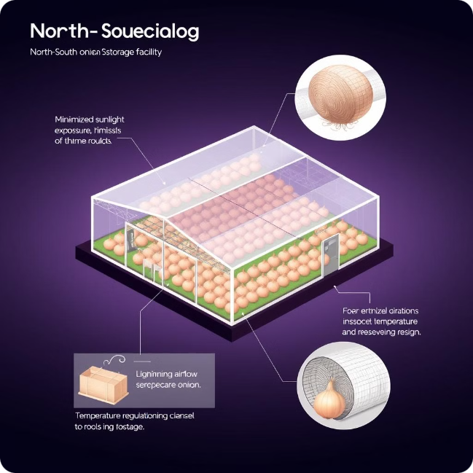



North-South Orientation
Sunlight Exposure
A North-South orientation minimizes direct sunlight exposure, preventing overheating and potential damage to the stored onions.
Optimal Ventilation
This orientation allows for natural ventilation, facilitating air circulation and promoting a dry environment within the storage space.
Temperature Regulation
The North-South orientation helps regulate the temperature within the storage space, maintaining optimal conditions for preserving the onions' quality.

Slide 9
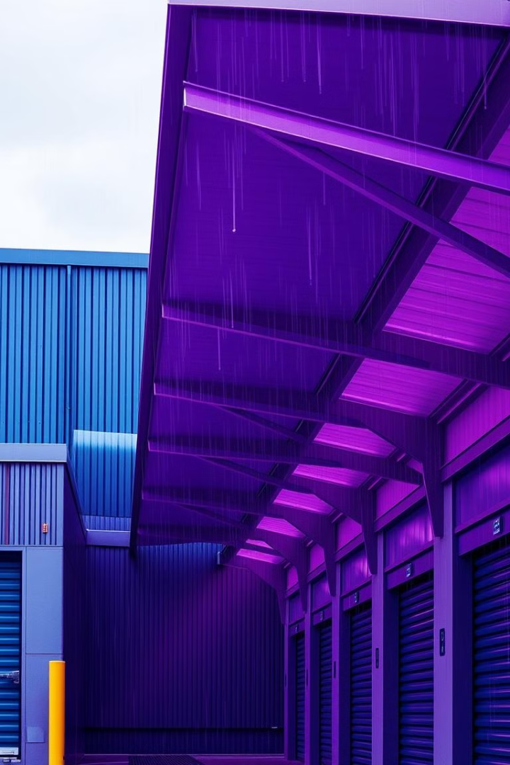
Proper Overhangs
1
Rain Protection
2
Sunlight Blocking
Overhangs prevent rainwater from directly entering the storage space, protecting the onions from moisture-induced spoilage.
Overhangs block direct sunlight, mitigating overheating and preventing the onions from becoming damaged by excessive heat exposure.
3
Temperature Regulation
4
Extended Shelf Life
Overhangs contribute to a more consistent temperature within the storage space, preventing extreme fluctuations that can negatively impact onion quality.
By protecting the onions from the elements, overhangs help maintain their freshness and extend their shelf life, minimizing waste and maximizing yield.

Slide 10
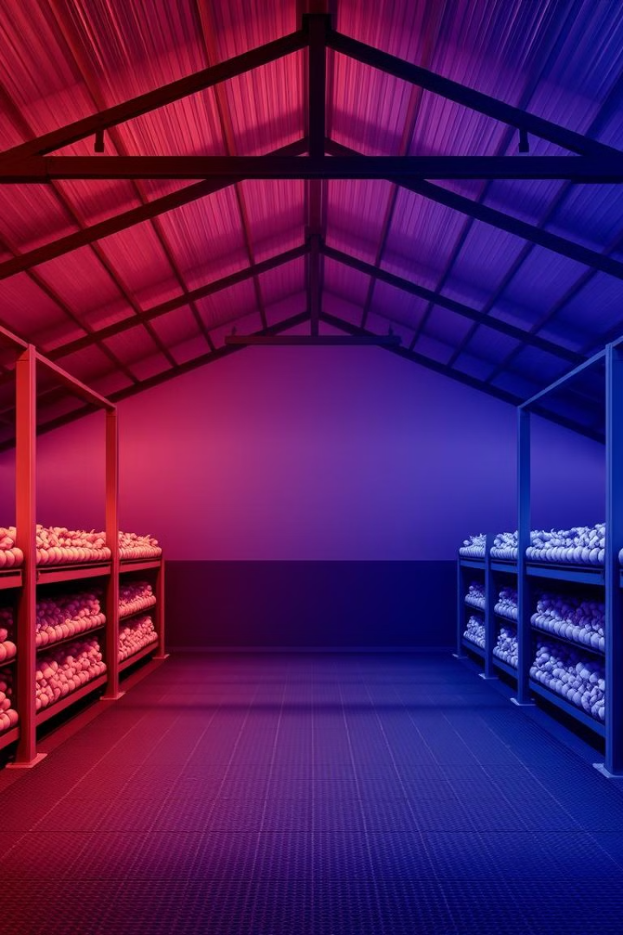
Protection from Sunlight and Rain
Roof Integrity
Foundation Strength
A sturdy roof is crucial to protect the onions from rain, wind, and other elements that can damage the crop. A well-maintained roof ensures a dry and protected storage environment.
A solid foundation prevents the storage structure from shifting or settling, ensuring stability and longevity. This protects the onions from potential damage caused by unstable conditions.
Proper Drainage
Regular Maintenance
Adequate drainage systems are essential to prevent water accumulation around the storage facility, protecting the onions from moisture-related problems.
Regular inspections and maintenance ensure the long-term integrity of the storage facility, minimizing the risk of damage and protecting the onions from the elements.

